Slide 1
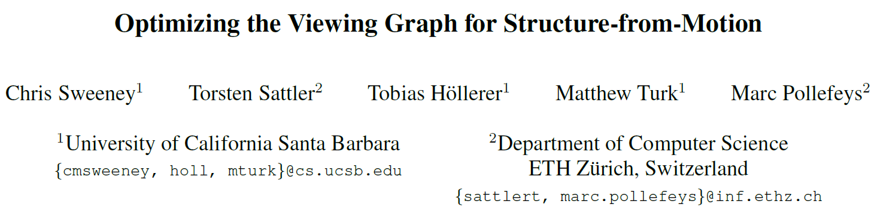
International Conference on Computer Vision (ICCV),2011.
Reporter: Ge Linlin
Date: 2019.05.27

Slide 2
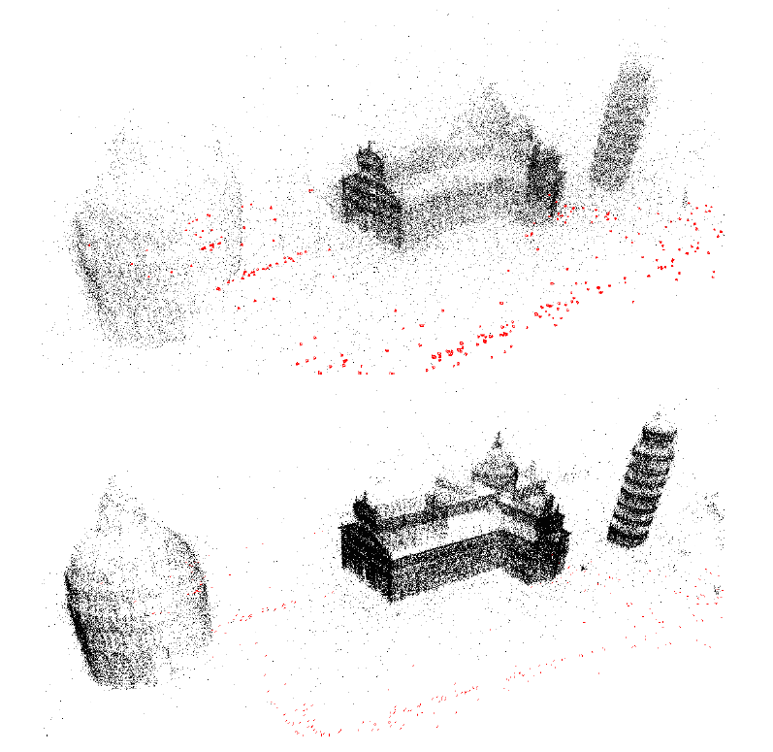
1. Introduction
In this paper, a novel pipeline for global SFM has been proposed. Compared to standard global SFM pipeline, it achieved great efficiency and accuracy.

Slide 3
1. Introduction
Contributions:
It is the first global SFM pipeline capable of handling uncalibrated image sets;
It provide a new method for calibrating cameras from a set of fundamental matrices.
The pipeline proposed in this paper achieves greater efficiency and comparable accuracy to the other methods.

Slide 4
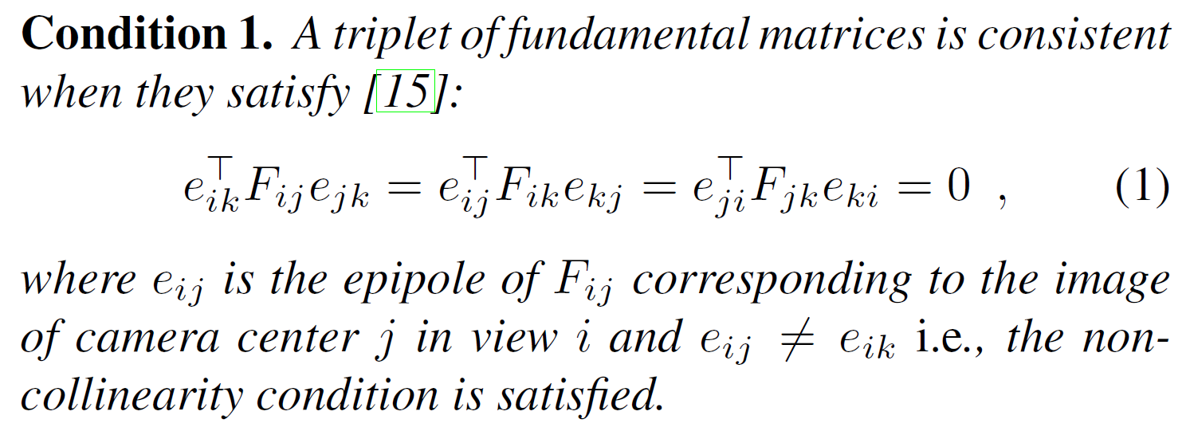
2. Basic Theories

Slide 5
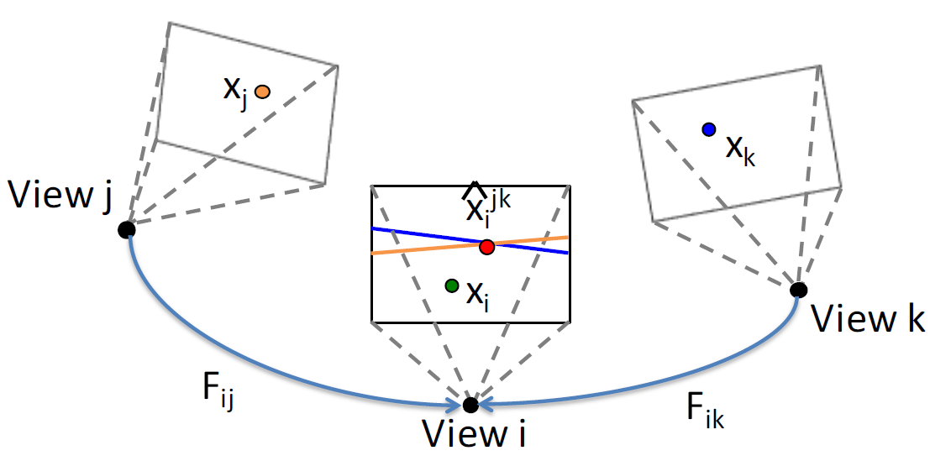
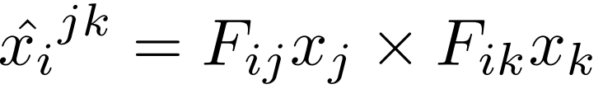
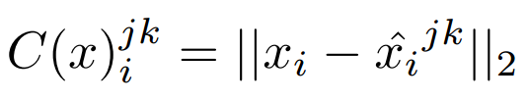
3. Create a Consistent Viewing Graph
Loop Consistency
Epipolar point Transfer:
Cost Function:

Slide 6
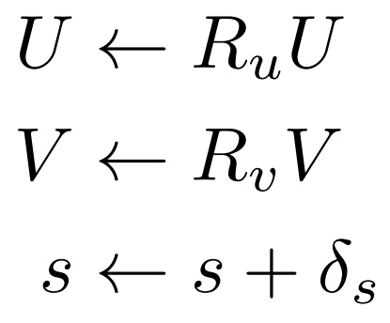
3. Create a Consistent Viewing Graph
Updating Fundamental Matrices

Slide 7
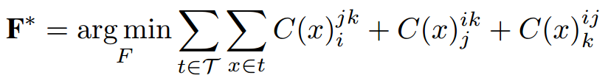
3. Create a Consistent Viewing Graph
Nonlinear Optimization

Slide 8
3. Create a Consistent Viewing Graph
Nonlinear Optimization
Condition 1
The transfer point lies on the trifocal plane of the image i, j and k.
Solution
Do not consider points where the two transfer lines are nearly parallel or the transfer lines lay near the epipole.
The latter scenario can be checked by examining the norm of the transfer line.
Condition 2
The tree camera centers are collinear.
Solution
Remove collinear triplets where the epipoles are equal.

Slide 9
4.1 Viewing Graph Optimization
Target
Find a minimal set of edges that provide sufficient coverage over all views in the viewing graph.

Slide 10
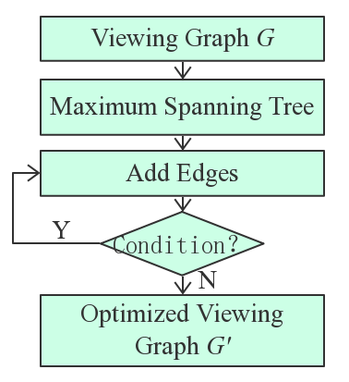
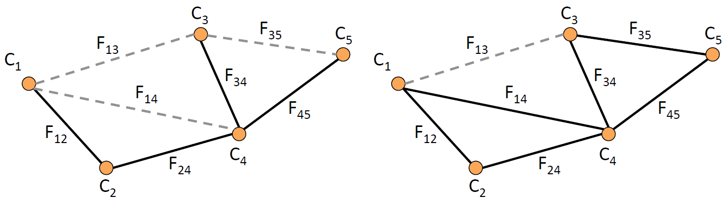
4.1 Viewing Graph Optimization
Edge Optimization
Condition
Every view is in at least one triplet.
There are no more “good” edges that can be added.

Slide 11
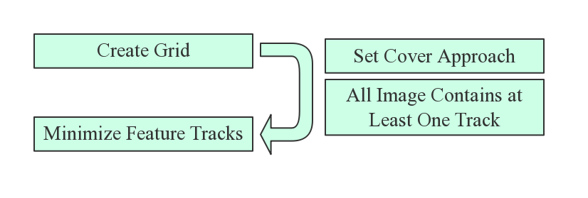
4.1 Viewing Graph Optimization
Features Optimization

Slide 12
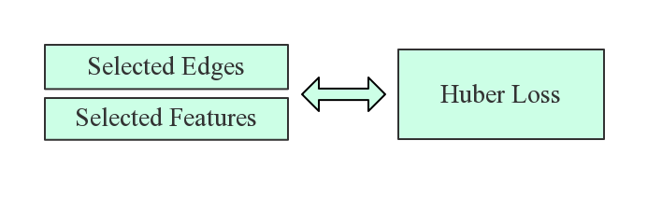
4.2 Viewing Graph Optimization
Optimization Structure

Slide 13
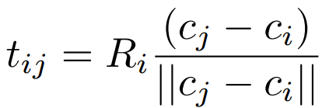
4.2 Estimating Motion
Assume cameras have been calibrated
Solve orientation
Cost function: relative rotation constraint
Use the angle-axis parameterization to solve for matrices
Initialization: chaining relative rotation from a random spanning tree
enforcing the relative rotation constraint

Slide 14
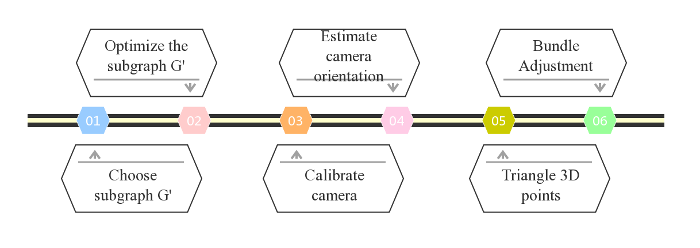
4.3 Pipeline

Slide 15
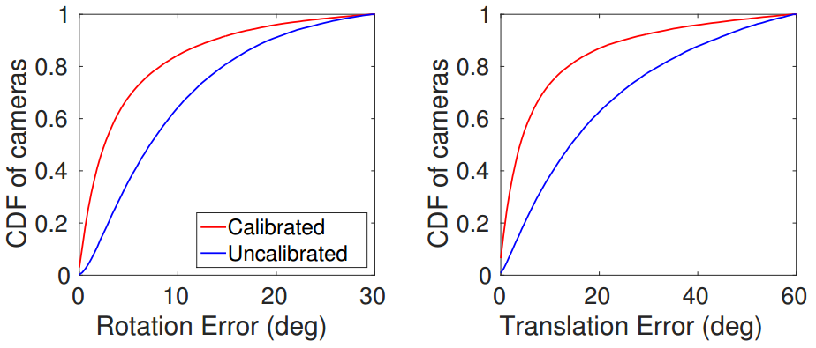
4.3 Calibrated Vs. Uncalibrated

Slide 16
5 Focal Length Calibration

Slide 17
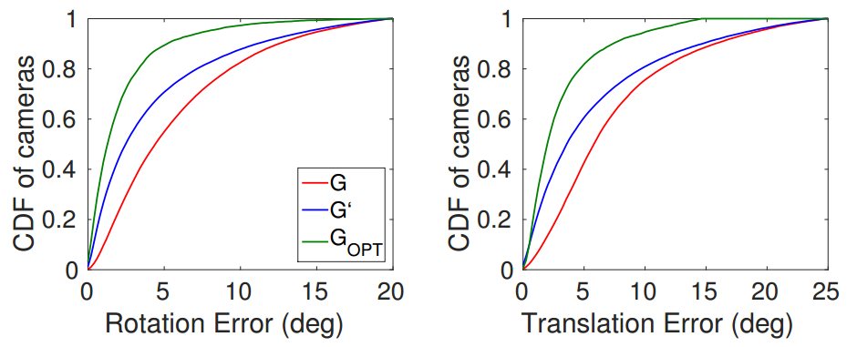
6 Test for Viewing Graph Optimization

Slide 18
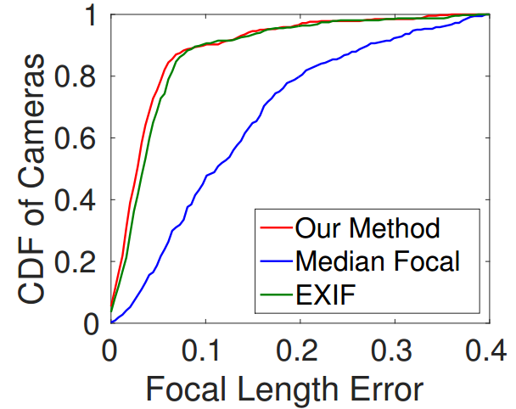
6 Results——Test for Focal Length Calibration

Slide 19
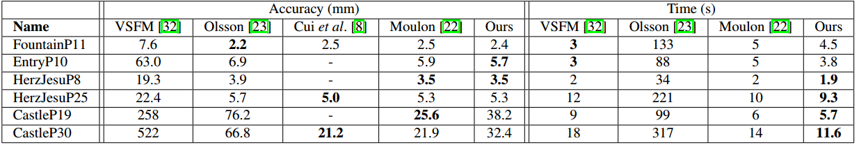
6 Results—— Test for Proposed Pipeline

Slide 20
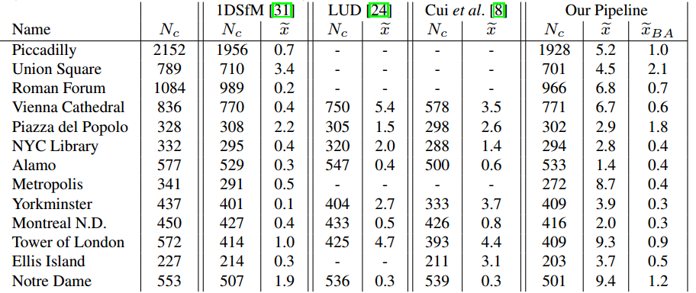
6 Results

Slide 21
5. Conclusion
wo

Slide 22
Q1: What is SO(3) rotation and O(3) matrices?
Q2: Why the epipole is in the null space of fundamental matrix？
Q3: What is the norm of transfer line?

Slide 23
Thanks!

